Slide 1

Hybrid Data Compression
Using Arithmetic Coding and Recurrent Neural Networks (RNN)
TEAM MEMBERS:
22MID0106 - PRAVEENA S
22MID0118 - PRARTHANA S
22MID0126 – BOOMIKA S

Slide 2
Introduction / Motivation
(Shannon–Fano as Existing System)
Why Data Compression?
Existing System: Shannon–Fano Compression
Driven by the immense growth of digital data in storage, cloud, and communication.
Employs symbol frequencies to assign unique prefix codes.
Necessity to reduce file size without any loss of critical information.
Known for its simplicity, speed, and ease of implementation.
Achieving better compression directly saves space, reduces time for transfers, and optimizes bandwidth usage.
Limitations of Shannon–Fano
Utilizes static probabilities that do not adapt to varying data contexts.
Fails to consider preceding symbols or inherent data patterns.

Slide 3
Problem Statement
Problem with the Existing System (Shannon–Fano)
Core Issue
Shannon–Fano's approach treats every symbol independently, resulting in inefficient code lengths and consequently, a higher compressed size than necessary.
Shannon–Fano bases code assignments solely on symbol frequencies.
It relies on static probabilities that remain constant throughout the file.
Crucially, it ignores patterns, context, and inter-symbol relationships.
This leads to sub-optimal compression ratios, particularly for intricate data.

Slide 4
Objectives
Specific Objectives
1
Analyze Shannon–Fano Limitations
2
Develop an RNN Model
3
Generate Adaptive Probabilities
4
Integrate with Arithmetic Coding
5
Implement Lossless Encoding/Decoding
6
Compare Compression Ratios
7
Evaluate System with SHA-256

Slide 5

Proposed System
6. Reconstructed Output
1. Input File
Recovered data
for verify
Raw data to
compress
2. RNN-Based
Probability
Prediction
5. Arithmetic
Decoder
RNN‑Assisted Compression
Decodes using
model
Predicts symbol
probabilities.
4. Compressed
Output
3. Arithmetic
Encoder
Encodes using
probabilities
Encoded bitstream

Slide 6
Results & Comparison
Test File
Original File Size: 6254 bytes
Existing System: Shannon–Fano
Compressed Size: 3563 bytes
Compression Ratio: 0.570×
Size Reduction: 43%
Reconstruction: ✔ Lossless (SHA-256 Match)
Proposed System: RNN + Arithmetic Coding
Compressed Size: 900 bytes
Compression Ratio: 0.144×
Size Reduction: 85.6%
Reconstruction: ✔ Lossless (SHA-256 Match)
Adaptive probabilities → much shorter codes

Slide 7
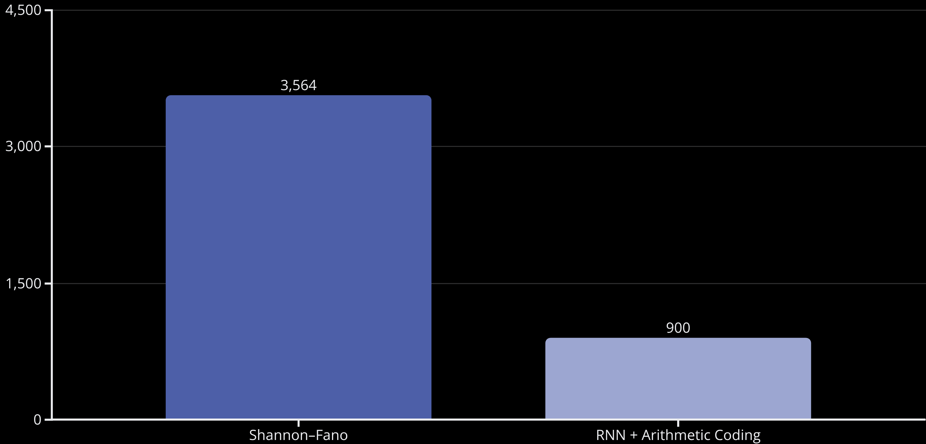
Proposed System: RNN + Arithmetic Coding

Slide 8

This Photo by Unknown Author is licensed under CC BY-SA

